Slide 1

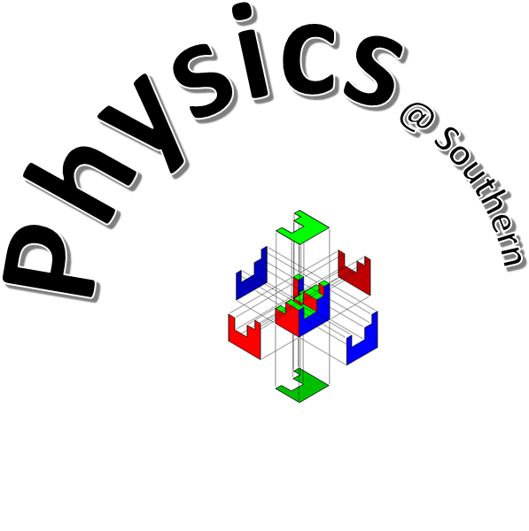

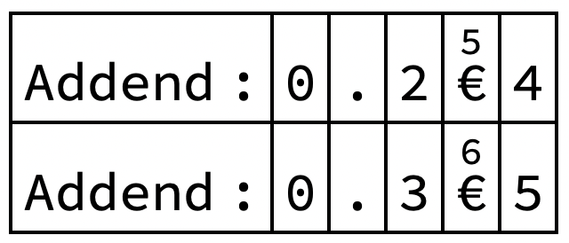
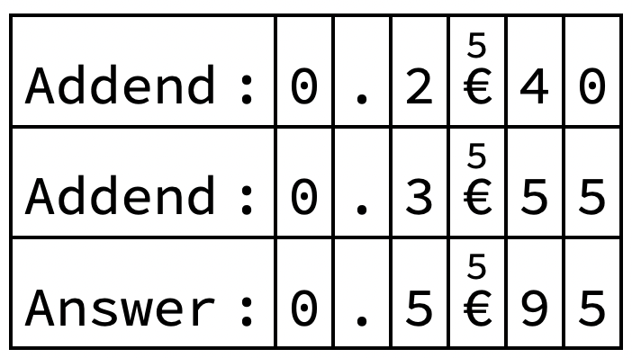
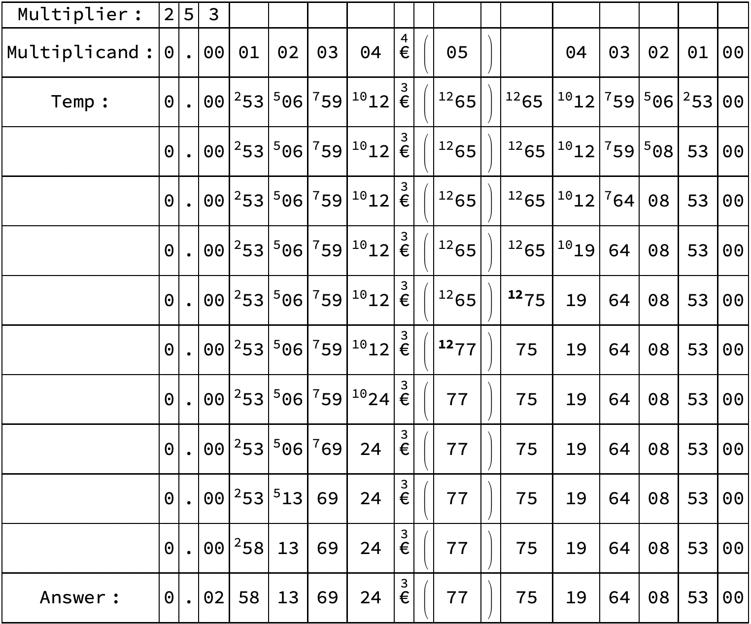
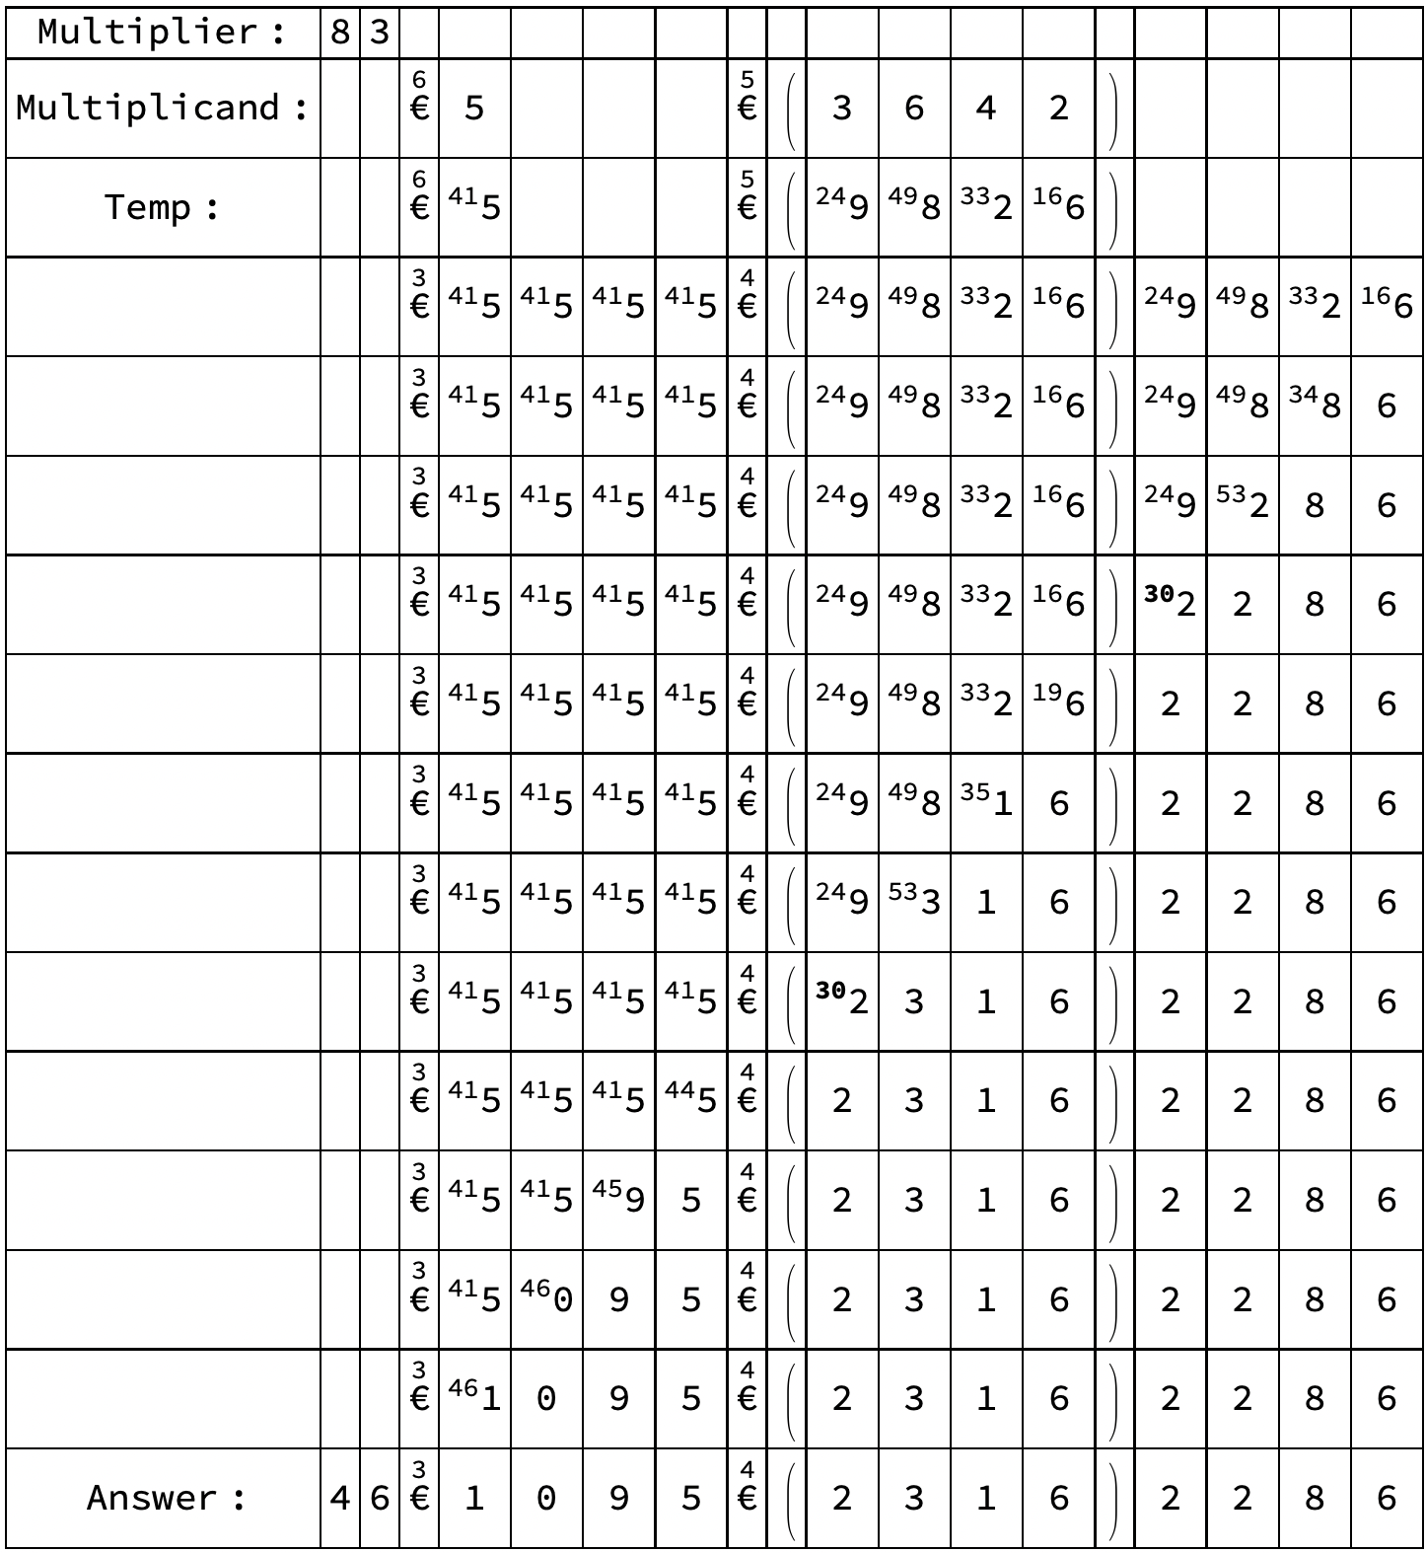
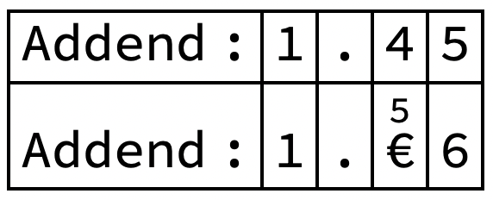
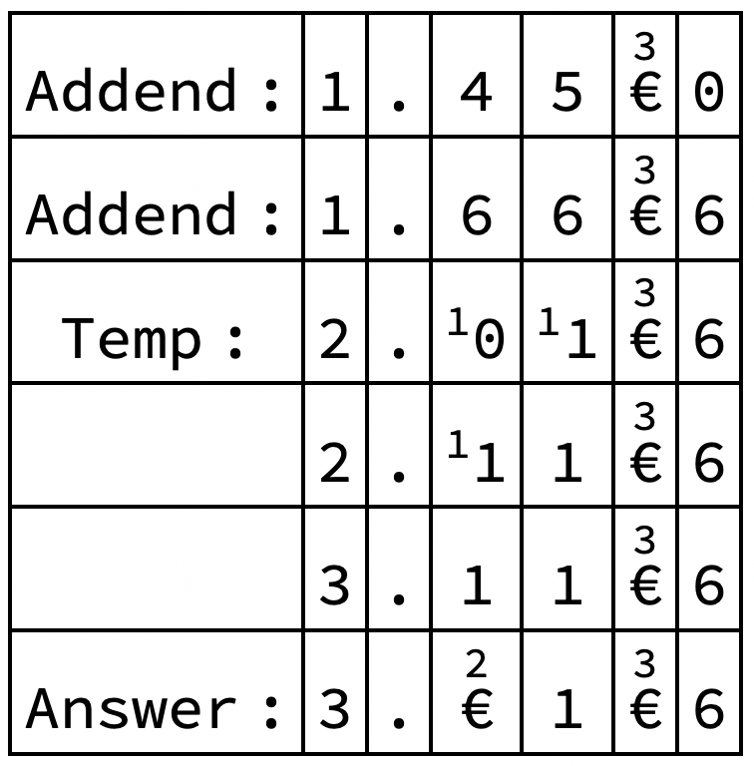



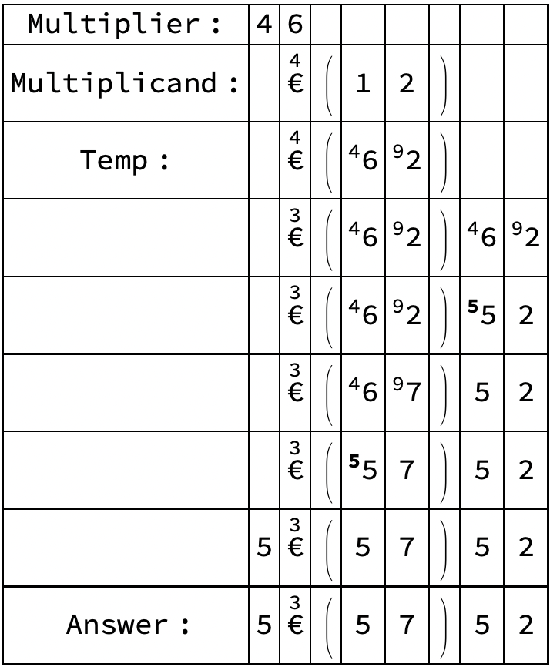
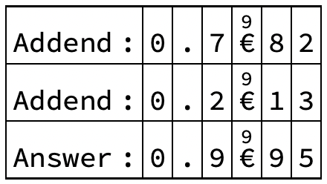
Indexed Concatenation (I-Cat): A Method for Representing and Operating on Repeating Numbers
Abigail Touma, Isaac Wolford, and Kenneth Caviness
School of Engineering and Physics, Department of Mathematics
Overview
Operations & Examples (cont.)
Operations & Examples (cont.)
Operations & Examples (cont.)
Indexed Concatenation (I-Cat) notation is a method for representing numbers with repeating patterns in a structured way.
Instead of treating repeating decimals or numbers with repeating digits as unstructured expansions, they are written as compact objects (I-Cats).
This makes patterns easier to identify and manipulate.
Standard numbers can be converted and used in operations using I-Cat notation.
Addition Examples (Increased Complexity):
(multiplication cont.)
I-Cat x I-Cat Example:
Each number is expressed in I-Cat form.
Repeating units are expanded for alignment.
The addition is then performed directly.
Multiplication is performed on each individual cell.
I-Cat Methods
First, the repeating block in a number is identified.
The repeating sequence is represented as a single-structured unit (I-Cat)
The number is rewritten using this compact form.
Now, different operations can be performed using I-Cat notation instead of individual digits.
I-Cat notation uses the symbol € to represent indexed concatenation.
No expansion required in this case.
Intermediate sums show how carries move across units.
The result is recompressed into I-Cat form.
Operations & Examples
Repeated Numbers to I-Cats:
Multiplication Method & Examples:
Applications
Multiply using the U = M/C method:
M: number of integers in the multiplier.
C: number of integers in the I-Cat.
U: number of times to unpack the I-Cat.
Carries are propagated across from left to right.
Compact representation of repeating patterns.
Simplifies arithmetic with infinite decimals.
Useful in mathematical and computational contexts.
Conclusion
I-Cat x I-Cat Method:
I-Cat notation provides a structured way to represent and work with repeating numbers.
It simplifies both representation and operations.
Addition Examples:
Future Work
More complex operations
Computational applications
Develop more efficient algorithms
Continue analyzing patterns
Acknowledgements
The I-Cats are already aligned with matching repeating lengths, so no further adjustment is needed.
Special thanks to Dr. Kenneth Caviness for his guidance and support.

